Slide 1
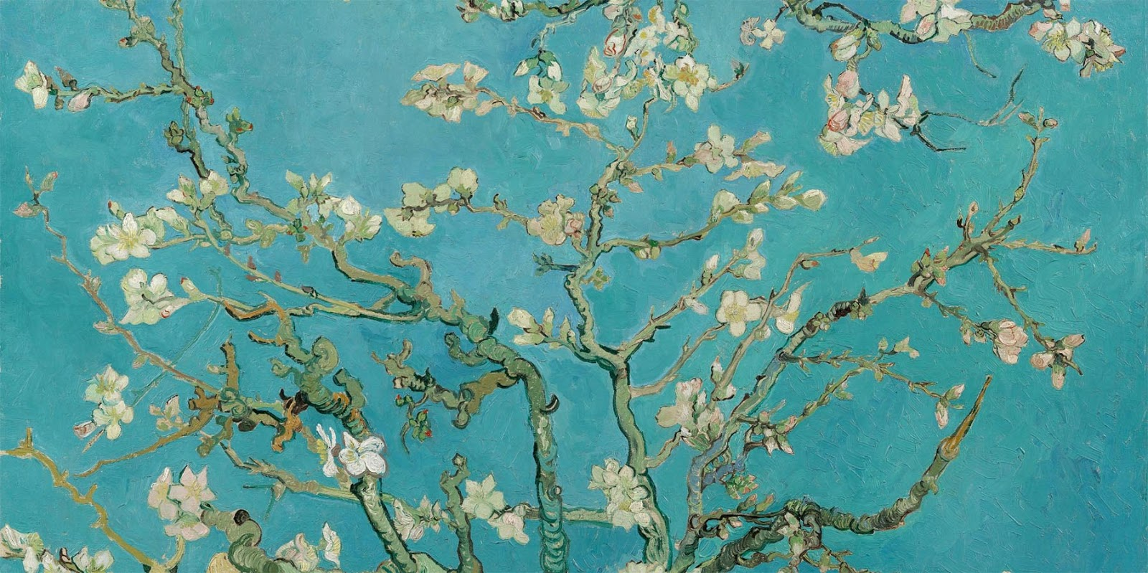
Van Gogh’s Almond Blossoms A Modern Masterpiece
Art History Portfolio
By Student’s Name
Today’s Date
This Photo by Unknown Author is licensed under CC BY-NC-ND
This Photo by Unknown Author is licensed under CC BY-NC-ND

Slide 2
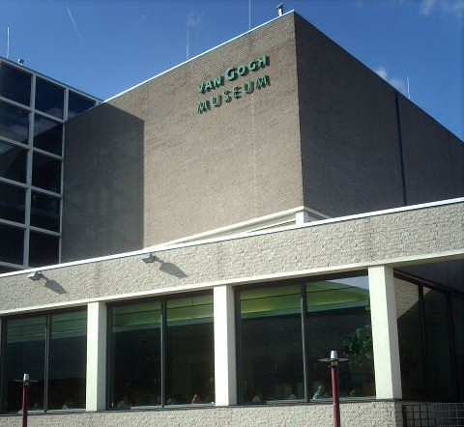
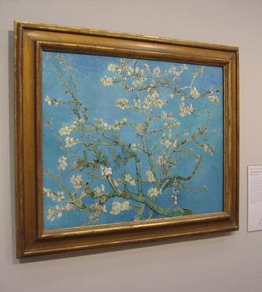
1. Who is the artist, artisan, or possible creator of this artwork? What is the artwork's name or title? If it was commissioned, who commissioned it?
Answer: Vincent Van Gogh painted “Almond Blossoms.” A noncommissioned artwork, Van Gogh painted it to honor the birth of his nephew, Vincent Willem.
2. When was it created? Where was it created? Where does it reside now?
Answer: Painted in Feb. 1890, Arles, France, this masterpiece resides in the Van Gogh Museum, Amsterdam, Netherlands.
3. How large or small is the artwork? What materials were used?
Answer: Dimensions: 73.3 cm x 92.4 cm. Materials: Oil on canvas.
This Photo by Unknown Author is licensed under CC BY-SA-NC
This Photo by Unknown Author is licensed under CC BY-SA
This Photo by Unknown Author is licensed under CC BY-SA

Slide 3
Van Gogh’s “Almond Blossoms”
Answer: Blossoms that cling to tree branches appear in free form. Time of year? Blossoms only bloom in the spring. Time of day? Perhaps late in the day. The middle of the day would shine much brighter. Van Gogh chose wisely to paint during softer hours. The dim, darkish background juxtaposed against the white-yellowish blossoms makes for a lovely contrast.
1. Can you identify any recognizable objects? Describe them. Where are they in the image? Are there free forms? Are people shown to you? What are they doing? Is a time, place, or event shown?
This Photo by Unknown Author is licensed under CC BY-SA

Slide 4
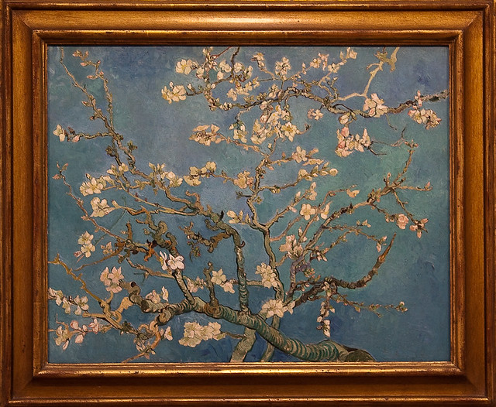
1. What kind of colors do you see? Describe them. Where do you see them? How are they used?
Answer: The turquoise sky represents the background. White, yellowish, pink colors signify the blossoms. Light and dark greens plus brownish-black outlines create the tree branches.
--------------------------------------------------------------------------------------------------------------
2. What kind of lines do you see? Describe them. Where do you see them? How are they used?
Answer: The lines are free-form, natural, and twisty. Just like tree branches appear in real-life.
5. Does the artwork have open and closed spaces? What takes up the most space in the work? If it is a two-dimensional work of art (flat), is there the illusion of three-dimensional space?
Answer:
---------------------------------------------------------------------------------------------------------------
6. Is value an important part of the artwork? Are there little or no changes in value? (This refers to value in terms of the lightness or darkness found in the artwork, and not monetary value or importance.)
Answer:
3. What kind of shapes or forms do you see? Describe them. Where do you see them? How are they used?
Answer: Shapes appear completely natural: Twisty, turning, reaching. Some upright & strong, some bent and unsure.
---------------------------------------------------------------------------------------------------------------
4. What kind of texture do you see? Describe them. Where do you see them? How are they used?
Answer: The texture seems soft on the blossoms and the branches too.
This Photo by Unknown Author is licensed under CC BY-SA

Slide 5
Works Cited
Van Gogh Museum. Retrieved Sept. 20, 2023 from https://www.vangoghmuseum.nl/en/collection/s0176v1962
This Photo by Unknown Author is licensed under CC BY-NC-ND

