Slide 1
Ancient Greek Homes
By: Student Name

Slide 2
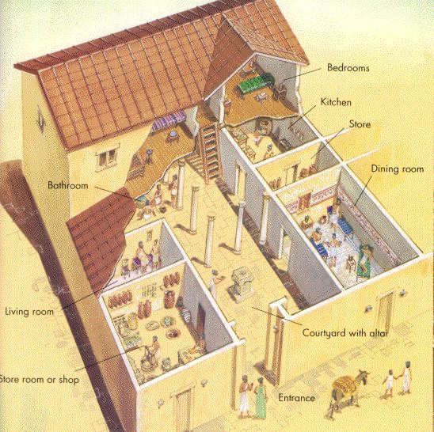
Interior of the Greek Homes
This is what a Ancient Greek home is supposed to have looked like. A bit of the exterior and a little description of the interior. On the left bottom, it’s supposed to say ‘Store room or shop’.

Slide 3
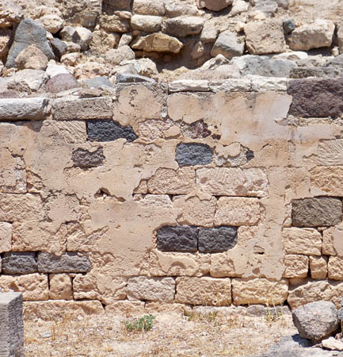
Materials for Ancient Greek Homes
Stone – They used the stone that was locally available. Primarily for the foundation, sometimes they used it for the walls.
Mud Brick – They took their time making the mud brick. Using: mud, straw, and water. They mixed those then let it dry in the sun.
Wood – Depending on what trees were available they used wood for door and window frames.
Clay Tiles – Clay Tiles were used for the roofs. It kept the house cool and they were fire resistant.
Plaster – Used to make smooth surfaces, made it from lime and sand.
Marble – Not normally used in homes due to expense, but was used in public buildings or more wealthier homes.

Slide 4
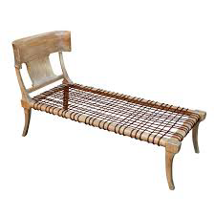
Furniture in Ancient Greek Homes
Stools
Couches
Small Tables
Chests
Chairs
Those listed were the few main items used in homes.

Slide 5
Work Cited
https://www.historyforkids.net/greek-homes.html#:~:text=Mud%20bricks%3A%25%20These%20were%20the,for%20door%20and%20window%20frames.
http://www.furniturestyles.net/ancient/.greek/

