Slide 1
Gods and Goddesses in Sculpture
Student Name Here
Art History B
Date Here

Slide 2
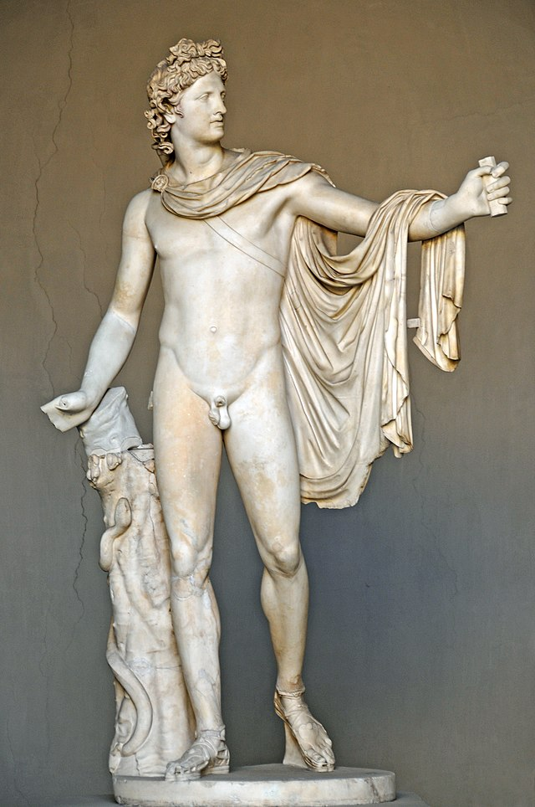
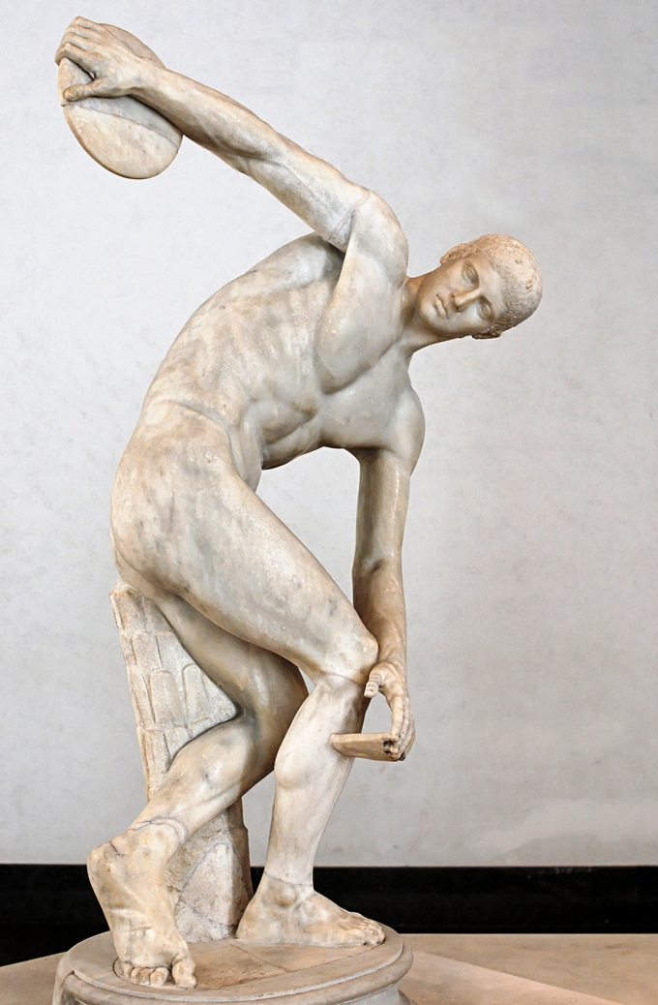
Classical Period
The Greek classical period was divided into three main stages with Early, High, and Late. When referring to Classical period most people refer to “High Classical”.
The classical period was mostly focused on beauty and the idealization of ideas or people.
The Classical period lasted around 480-300 bce.

Slide 3
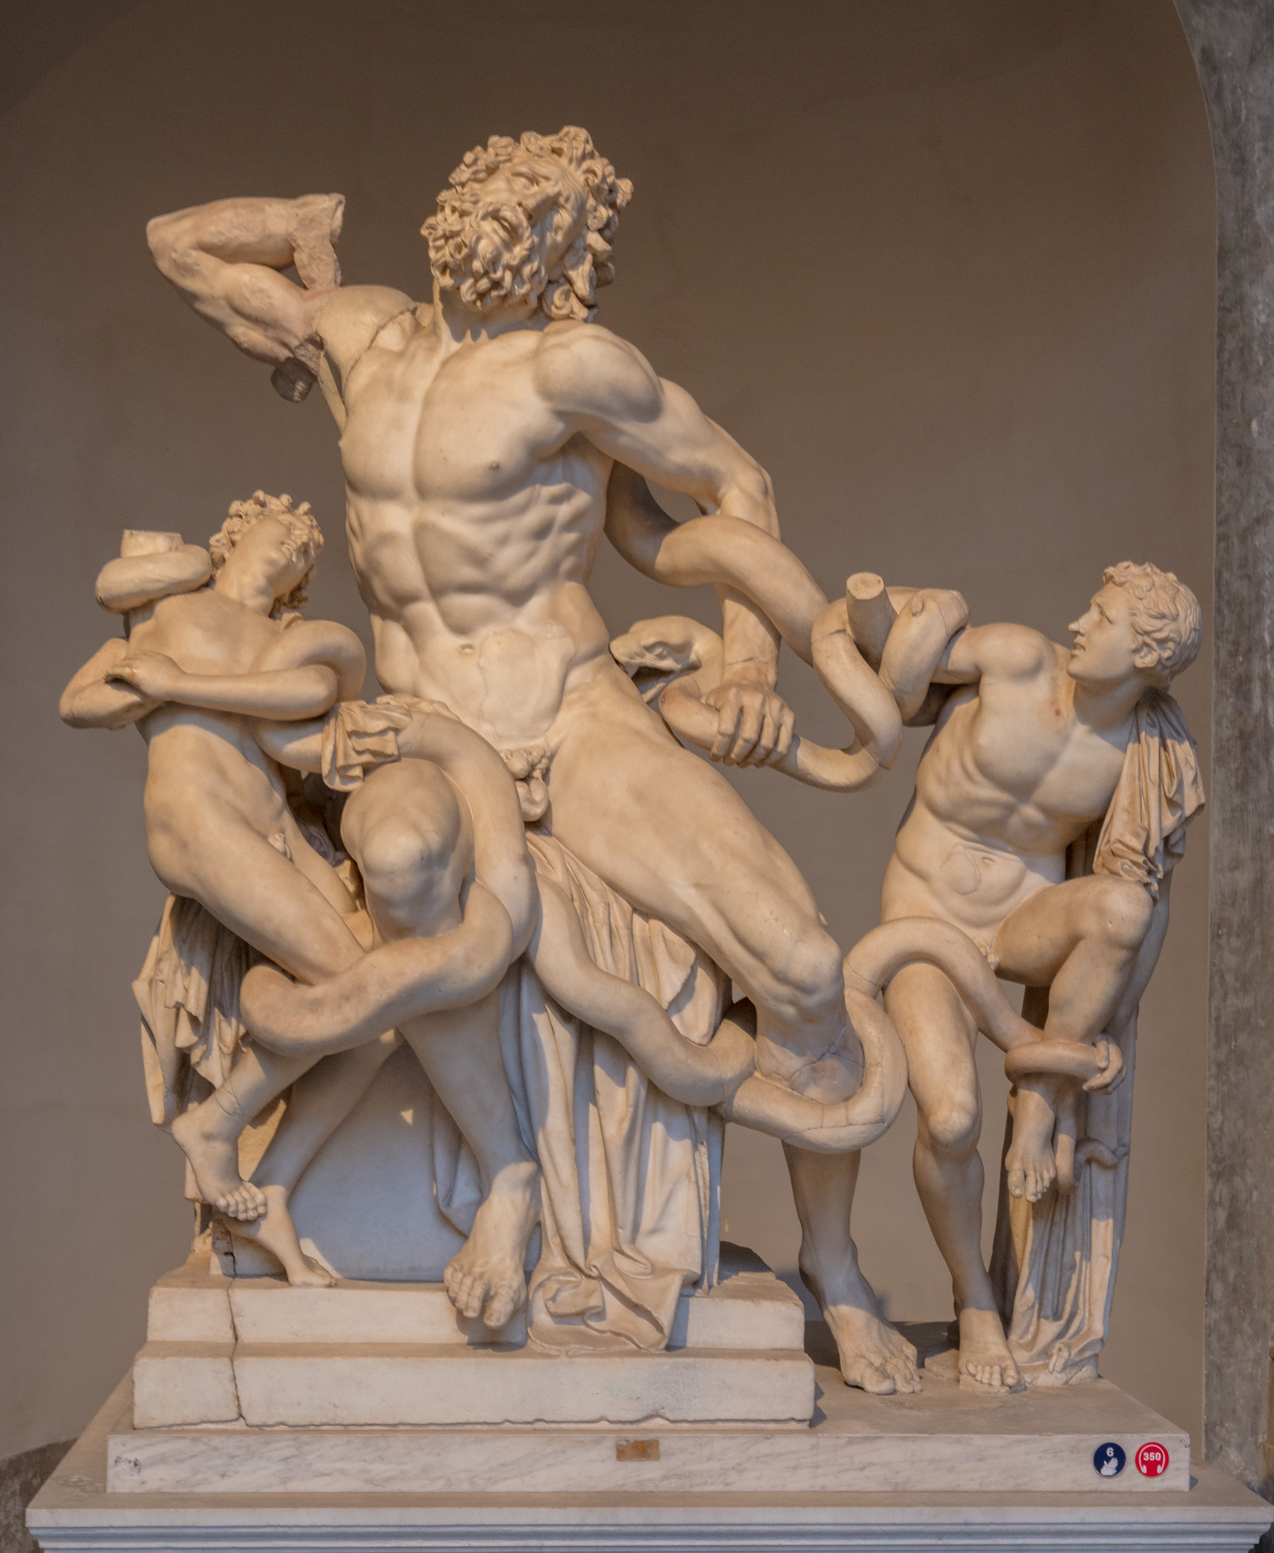
Hellenistic Period
The Hellenistic Period lasted between 323 B.C.E and 31 B.C.E. It was mostly focused on the depiction of emotion, realism, and movement.

Slide 4
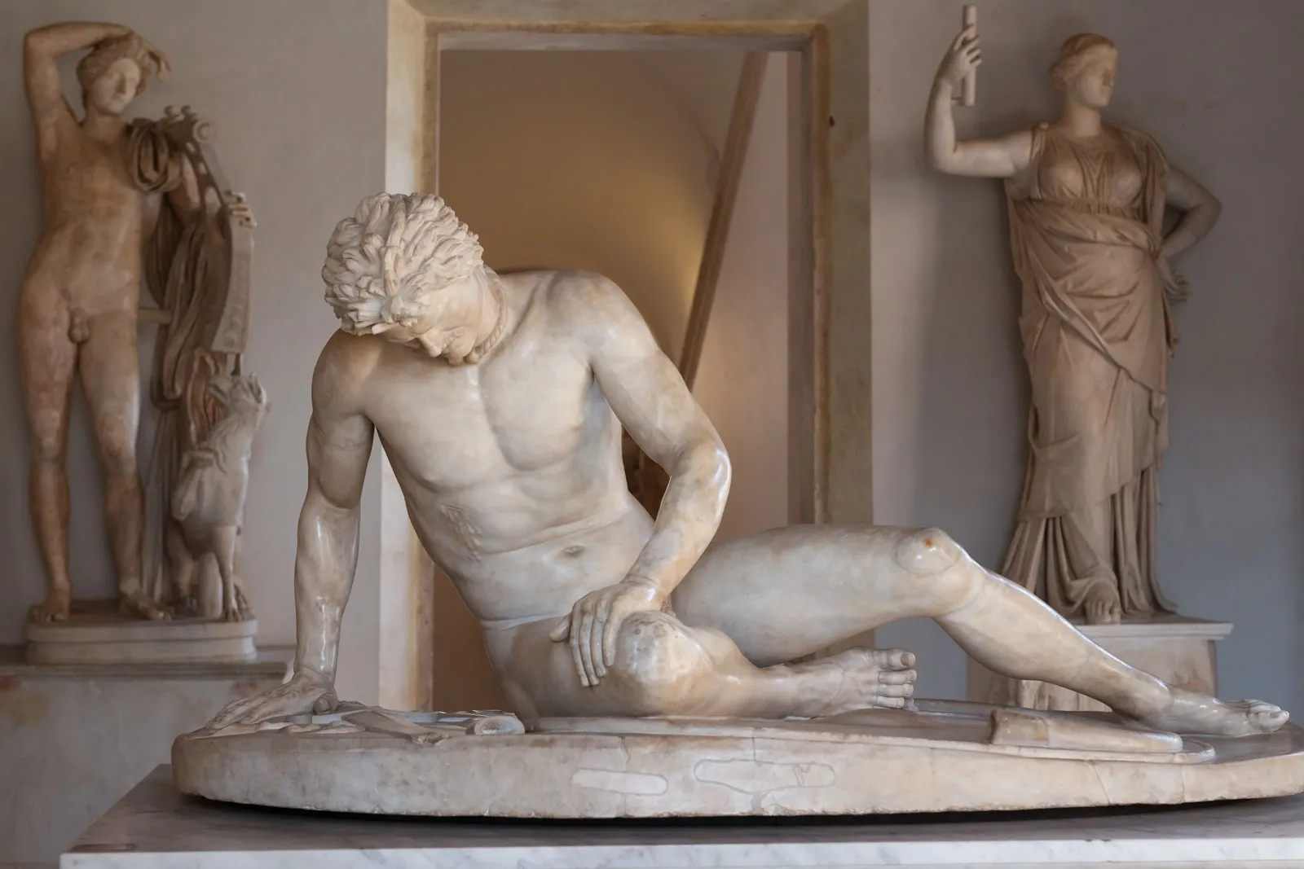
Treatment of Gods and Goddesses in Sculpture
The greeks gods and goddesses had statues that were more naturalistic and human though they were idealized as well.

Slide 5
Works Cited & Img source
“Greek God Symbols • Greek Gods & Goddesses.” Greek Gods & Goddesses, 24 Oct. 2023, greekgodsandgoddesses.net/greek-god-symbols/.

